Slide 1

Real-Time Brain-Mobile phone Interface
NeuroPhone
Faculty of Computer and Information Science
Ain Shams University

Slide 2
Supervisors
Dr. Manal Tantawi
TA. Omer Shrif

Slide 3
Proudly presented by
Abdelrahman Sayed Ali Mohamed.
Ayman Hassan Twfiq Abd-Elhafez.
Mohammed Nour Eldin Abbas.
Nora Ekramy Ali Yossef.
Norhan Abdelkarim Khalf Abdelhafez.
Nour Mohamed Hussein Mahmoud Mohamed Kamaly.

Slide 4
Agenda
Problem definition
Motivation for developing a NeuroPhone
Objective of our work
Survey information
Identification and justification of proposed methodologies
Resources needed by the project

Slide 5

Problem Definition
There are several ways of human-machine interaction (Mouse, Keyboard and touch screen).
There were also other touchless approaches such as Kinect developed by Microsoft for the Xbox 360 video game console.
But all these ways Depend on physical activity from the human.

Slide 6
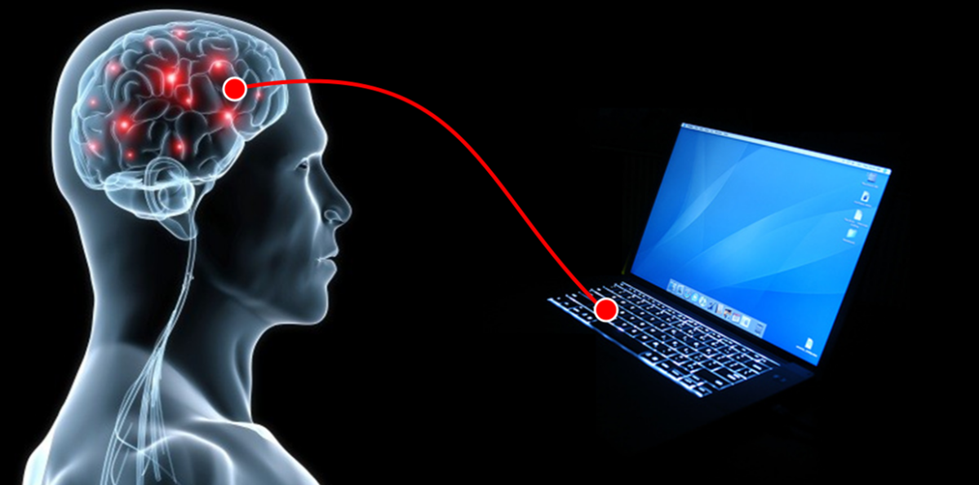
Problem Definition
people with Motor disabilities cann’t access their computers and smart phones.
This barrier could be overcome by Brain-Computer Interface (BCI) also known as Mind-Machine Interface (MMI) technology.
Direct pathway between brain and an external device.

Slide 7
Problem Definition
EEG signals are signals elicited by brain neurons.
The wireless EEG headset would transmit EEG signals (including p300 signal) via Bluetooth.
The Mobile Phone application would in turn receive the signal and by using deep learning techniques deployed in that application would detect and capture those signals.

Slide 8
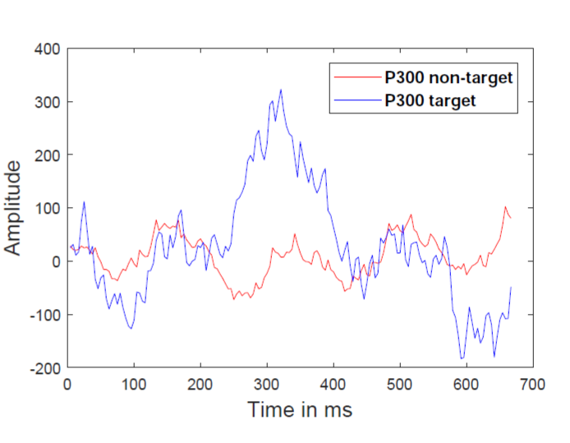
Problem Definition
A P300 target appears in (EEG) signal when a random visual stimulus occurs to the subject.
The signal is called as P300 because a positive peak appears after 300 ms of the stimulus.
The visual representation of P300 target and P300 non-target is shown in this figure.

Slide 9
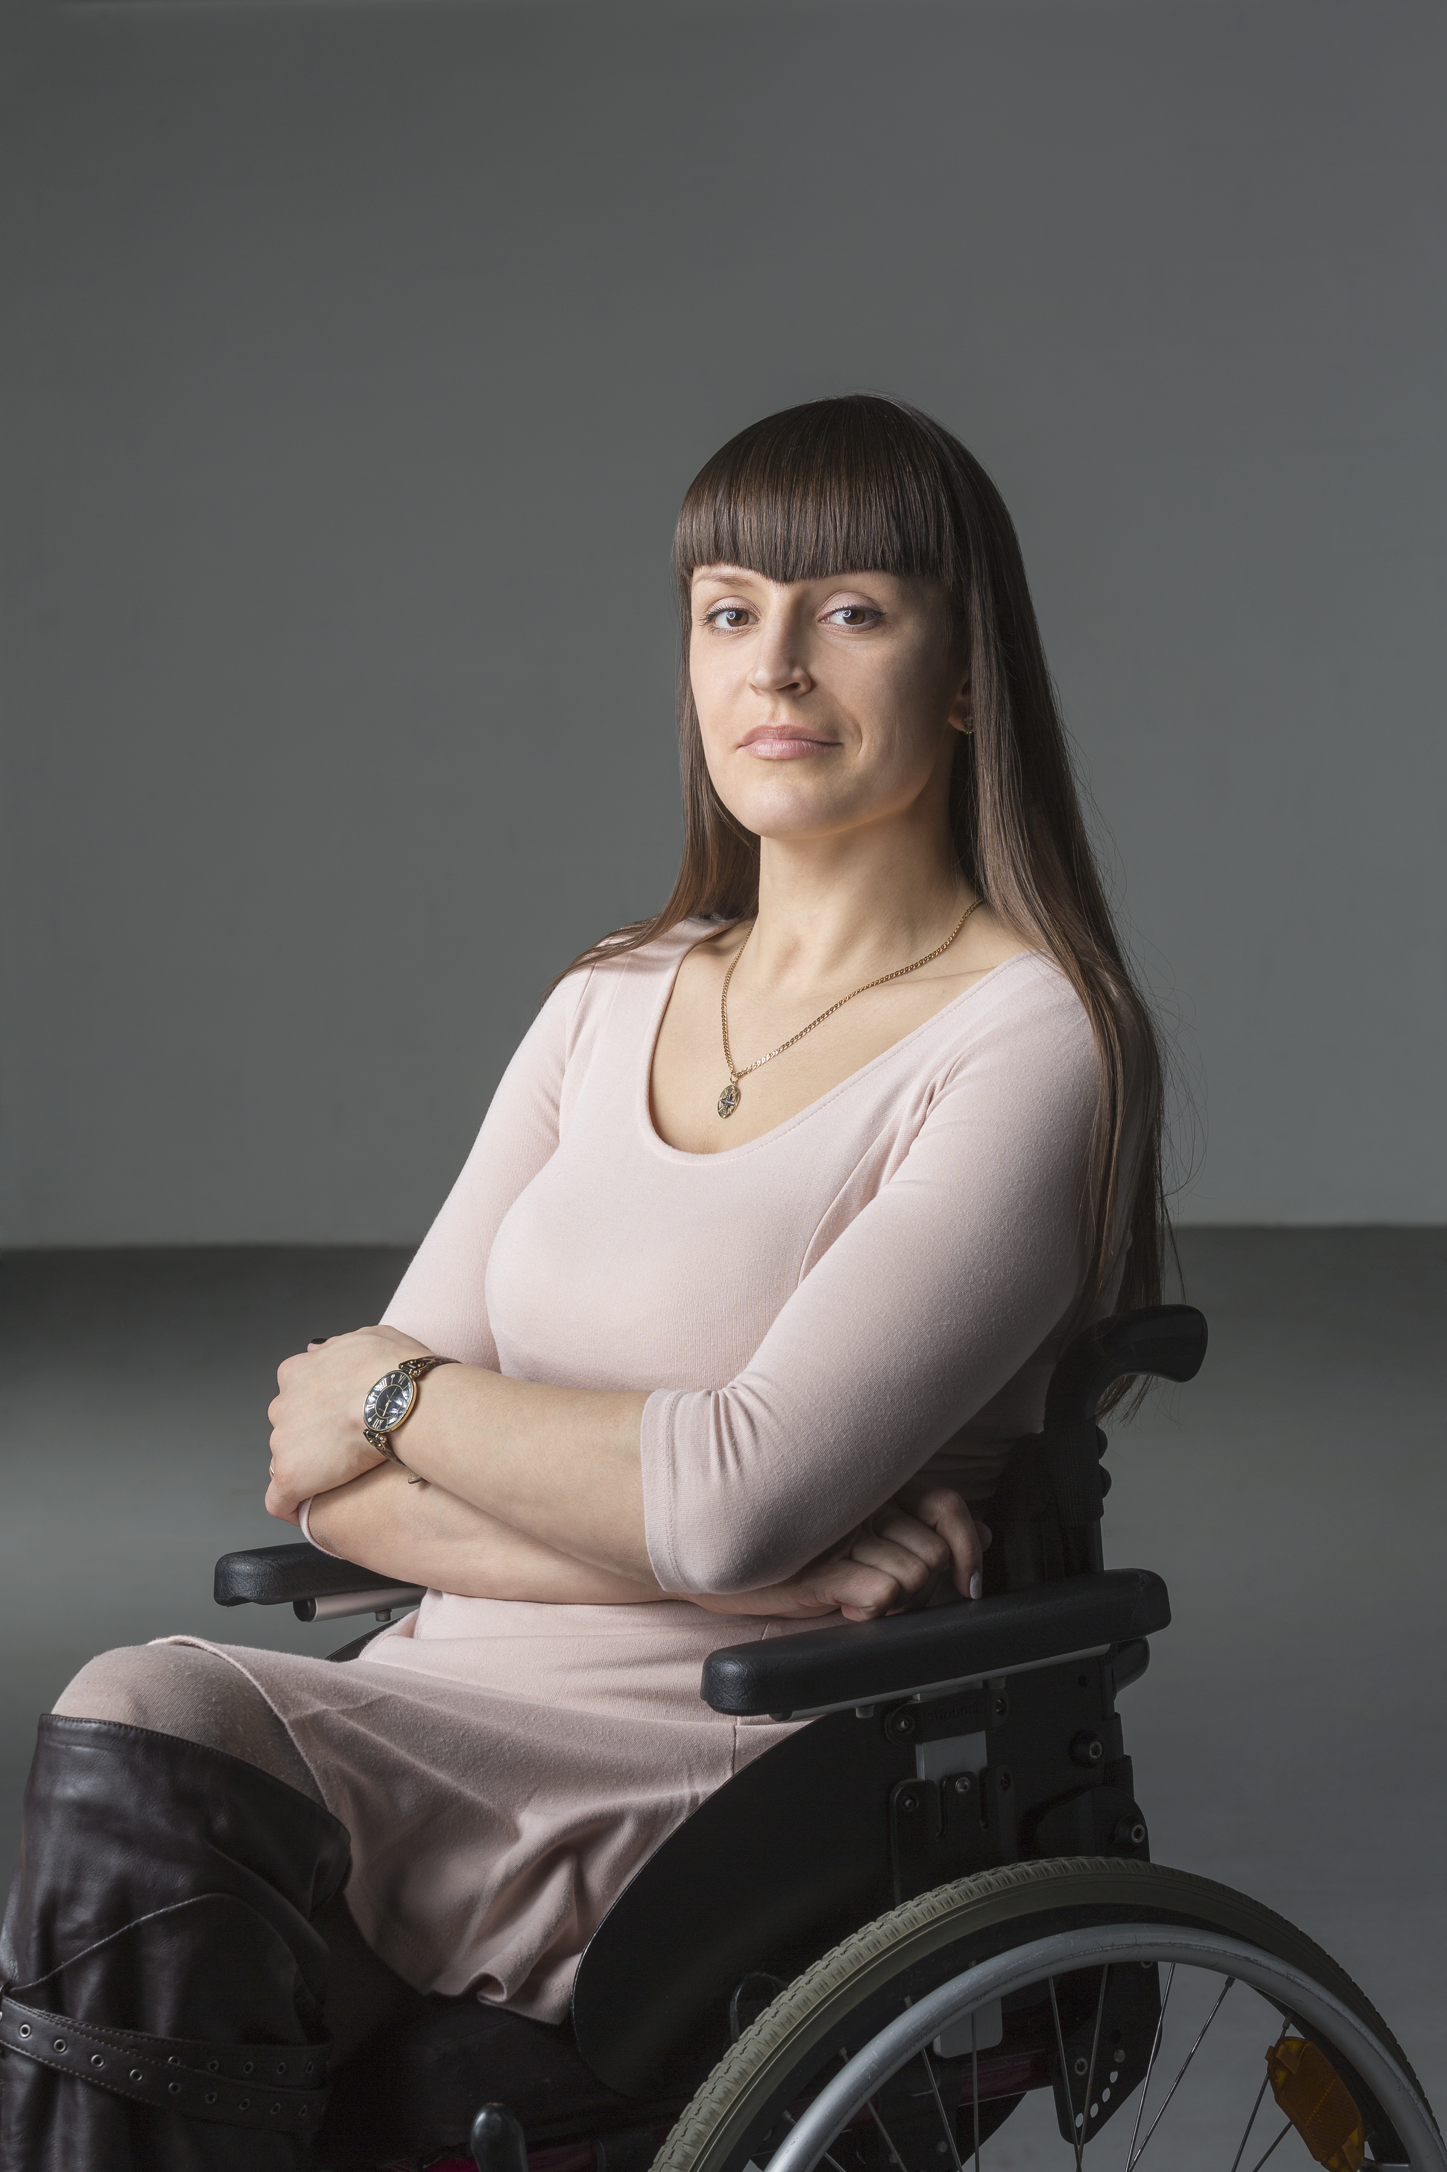

Motivation
According to the World Health Organization (WHO), over 1 billion people are estimated to suffer from a disability.
This corresponds to about 15% of the world's population.
BCI applications allow for a seamless connection between the device and disabled user that assists them in carrying out essential life tasks.

Slide 10
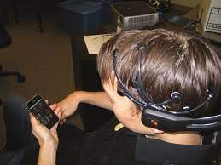
Objective
Providing a BCI-based mobile phone communication application that would serve people with motor disability.

Slide 11
Name | Date | Dataset | Preprocessing | Modeling | Results
Single-trial stimuli classification from detected P300 for augmented Brain–Computer Interface: A deep learning approach | Sep-2022 | Collected from 22 subjects,11 males and 11 females, aged from 19-30 | - EEG signals were sampled at a rate of 512 Hz, amplified with half-amplitude band pass of 0.016–70 Hz then an offline band-pass filter was then applied, between 0.1 Hz and 20 Hz - Data was presented in the form of 3D matrix | A 2-level hierarchal CNN-LSTM | - First Level that predicts target or not target: Accuracy: Male = 80.7 ± 6.6 Female= 87.3 ± 4.3 - Second Level that determines whether it’s a visual or audio Accuracy: Male 92.8 ± 8.0 Female= 94.6 ± 4.5
Data Augmentation for P300-based Brain-Computer Interfaces Using Generative Adversarial Networks | 2021 | a P300-based BCI Speller system used an overt attention mode Consists of 16 electrodes, gathered from 10 females, mean age 26.8 ± 5.6 | EEG signal has amplified with a sample rate of 256hz High pass filter with cutting frequency of 0.1hz Low pass filter with cutting frequency of 20hz The data is normalized by applying a min-max normalization. | deep convolutional GAN (DCGAN) , Wasserstein GAN with gradient penalty (WGAN-GP) , deep convolutional GAN (DCGAN) | subject-specific 11% improvement , subject-independent no improvement
A Smart Home Control Prototype Using a P300-Based Brain–Computer Interface for Post-stroke Patients | Dec 2020 | BCI competition II and BCI competition III dataset, The EEG data acquires through 64 channels | Down sample the EEG signal from 2400 to 120 Hz, six-order bandpass Butterworth filter with cut-off frequencies 1 and 15 Hz, each channel signal under the 10th percentile and above 90th percentile was replaced by the 10th percentile or the 90th percentile, Data was extracted between 0 and 1000 ms posterior obtaining 120 samples per trial, the data was standardized | MLP ,SVM | SVM has achieved around 78% and 69%. MLP has achieved above 91.79% and 89.76%.
MsCNN A Deep Learning Framework for P300-Based Brain–Computer Interface Speller | 2019 | Data was collected from volunteers grouped by healthy and disabled subjects, aged between 20 and 55 six healthy participants (S01 to S06) and three post-stroke patients (S07 to S09) | According to the prior knowledge of P300, it is assumed that after the stimulus, 667 ms of EEG datais sufficient for P300 based character recognition [11].● An eight order Chebyshev Type I bandpass filter of cut-off frequency 0.1-10 Hz is used to filter theEEG signal | modelis proposed as it extracts multi-resolution deep features from the data. These features learn diverseinformation from the acquired EEG signal.

Slide 12
Name | Date | Dataset | Preprocessing | Modeling | Results
Deep Learning-based Classification for Brain-Computer Interfaces | 2017 | the SSVEP dataset-The experiment consists of 256 channel SSVEP recordings of 11 subjects (8 males and 3 females) with a sampling frequency of 250 Hz | The EEG signals are normalized, bandpass filtered between 5-48 Hz, and notch filtered at 50 Hz | Traditional Classifiers(KNN / decision trees / MLP / SVM / SVMG (Gaussian kernel))Deep Learning methods(CNN / RNN with LSTM architecture)Num of Classes: recordings of 11 subjects Mean | CNN:69%RNN with LSTM:67%
P300-based Applications for Interacting with Smart Mobile Devices | 2015 | recorded EEG activity from 6 healthy subjects: 5, males and 1 female, with age ranging from 21 to 33.-Data was recorded using the wireless consumer, Emotiv EPOC neuroheadset which has 14 electrodes located at -20 characters as training data and an unlabeled online testing dataset of 12 symbols | signals were preprocessed using CommonAverage Reference (CAR) filter and moving average filter toremove the noise-A moving average window of 13 samples was thenapplied to each channel to smooth the recorded data | using ensemble learning modelFisher’s Linear Discriminant (FLD) finds the best decision boundary | 83%
Asynchronous P300-Based Brain-Computer Interface to Control a Virtual Environment | 2011 | Pre-collected Data: the dataset was collected from 11 healthy young subjects related to the collected Data but in a different shape Collected Data: Data were collected from 7 subjects using BCI2000 framework in two record sessions Speller session and a Domotic session Each session consisted of 10 run | features were extracted from The EEG signal using Stepwise Linear Domotic session in each session and performed 6 round cross-validation | Classification model Speller session The classification was made to recognise 5 common Dutch words WATER, WATER, KOPJE, BROOD and KLEIN Domotic session The classification was made in 2 different modes asynchronous and synchronous classifier | Speller session All subjects except Subject 3 exceeded the level of 80% Domotic session Synchronous there were on average 18.57% wrong classificationsAsynchronous error rate dropped to 1% Confession matrix 0.225 false positives/minute
NeuroPhone: Brain-Mobile Phone Interface using a Wireless EEG Headset | 2010 | We use the Emotiv EPOC headset which has 14 data-collecting electrodes and 2 reference electrodes | we are averaging data fora better Signal to Noise Ratio (SNR).we can still improve the EEG signals for better P300 detection, We use a bandpass filter to get rid of anynoise that is not in the P300 frequency range. signal processing is unnecessary for wink mode becausewink signals are much more easily detectable in raw EEG data | Bayesian classifier is used for wink mode and a simple decision stump is used for the think mode.num of classes:"The headset samples all channels at 128 samples/second. each of which is a 4-byte floating point number corresponding to the voltage of a single electrodeuse Emotiv EPOC headset which has 14 data collecting electrodes and 2 reference electrodes.(AF3 ,AF4 ,F3 ,F4 ,F7 ,F8 ,FC5 ,FC6 ,T7 ,T8 ,CMS ,DRL ,P7 ,P8 ,O1 ,O2)"Mean | CNN:69%RNN with LSTM:67%

Slide 13
Comments
EEG signal has amplified with a sample rate of 256hz.
High pass filter with cutting frequency of 0.1hz.
Low pass filter with cutting frequency of 20hz.
The data is normalized by applying a min-max normalization.

Slide 14
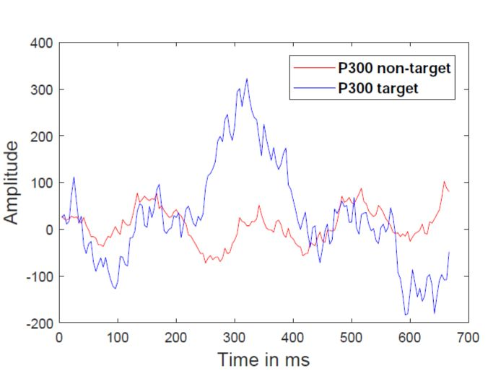
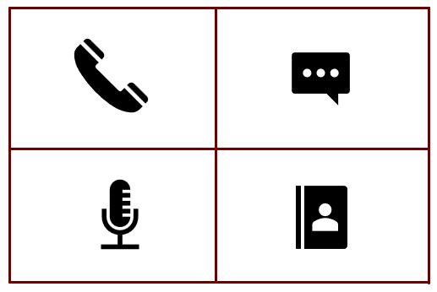
System flow
Preprocessing
Model
Augmentation
Notes:
Our approach is very simple to take the EEG signal , applying preprocessing , modeling

Slide 15
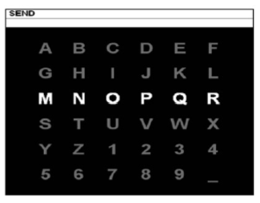
Dataset
BCI competition II consists of a single subject data, which contains 42 training and 31 testing (8 words) characters.
Dataset II of the BCI competition III contains the data of two subjects, subject A and B. It contains 85 training and 100 testing characters for each subject.
A 6 * 6 speller matrix is used for the data collection as shown in Figure.
The rows and columns of the speller matrix intensified randomly at a rate of 5.7 Hz.
The BCI paradigm is intensified for 100 ms and remains blank for 75 ms

Slide 16
Preprocessing
EEG signal has amplified with a sample rate of 256hz.
Band pass filter between 0.1 HZ and 20 HZ.
The data is normalized by applying a min-max normalization.

Slide 17
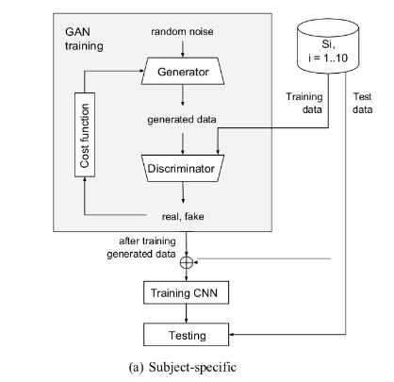
Augmentation models
Wasserstein GAN with gradient penalty (WGAN-GP)
Generator model
two 2D transposed convolution layers followed by batch normalization and ReLU operators
One 2D convolutional layer followed by the tanh activation function
discriminator model
three 2D convolutional blocks, where each includes one 2D convolutional layer with Leaky ReLU activation
The output of the last convolutional block is flattened into a vector to be processed into a fully-connected layer followed by a sigmoid activation

Slide 18
Model
A 2-level hierarchal CNN-LSTM model:
2D max pooling and dropout layers to reduce overfitting
ReLU activation function and batch normalization to speed the learning process
Adam optimizer with 1e-4 learning rate
10-fold cross validation

Slide 19
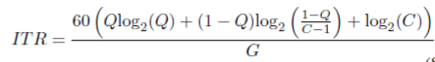
Evaluation
Accuracy and precision.
Information transfer rate (ITR), which measures the character recognition speed of the BCI system. The unit of ITR is bits per minute (bpm). The ITR is defined as

Slide 20



Tools
Python
PyTorch
Google Co-lab

Slide 21
References

